Slide 1
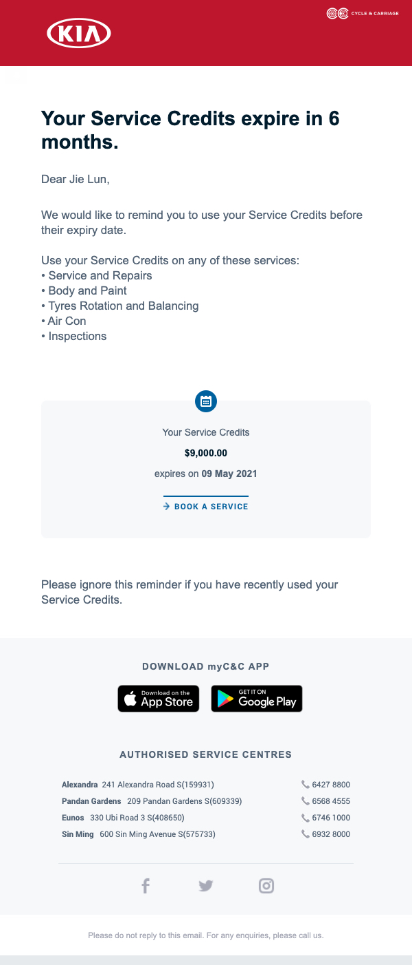
Email Subject: Your Accessories Credits expire in 6 months
Replace all red boxed words with Accessories
Entire copy to replace with:
We would like to remind you to use your Accessories Credits before they expire.
To do so, visit eShop from myC&C mobile app.
Add on the following sentence:
For Terms & Conditions, visit here (hyperlinked to respective brand’s T&Cs page)
Kia- https://www.cyclecarriage.com/sg/-/media/jccl/aftersales/kia/tcacscnov2020kia.pdf
Mitsubishi - https://www.cyclecarriage.com/sg/-/media/jccl/aftersales/mitsubishi/tcacscnov2020mit.pdf
Citroen - https://www.cyclecarriage.com/sg/-/media/jccl/aftersales/citroen/tcacscnov2020cit.pdf
DS - https://www.cyclecarriage.com/sg/-/media/jccl/aftersales/ds/tcacscnov2020ds.pdf
Replace with:
SHOP NOW
(deeplink to eShop section in mobile app)
Remove service centre section
Change last sentence to:
For any enquiries, please email us at eshop@cyclecarriage.com.sg

